Slide 1
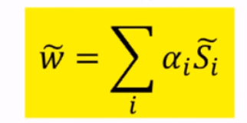
SVM Support Vector Machine
Dr. Shamim Al Mamun
Associate professor
Institute of information technology
Jahangirnagar university

Slide 2
What is Support Vector Machine
A Support Vector Machine (SVM) is a discriminative classifier formally defined by a separating hyperplane. In other words, given labeled training data (supervised learning), the algorithm outputs an optimal hyperplane which categorizes new examples. In two dimentional space this hyperplane is a line dividing a plane in two parts where in each class lay in either side

Slide 3
LSVM
Non-LSVM

Slide 4
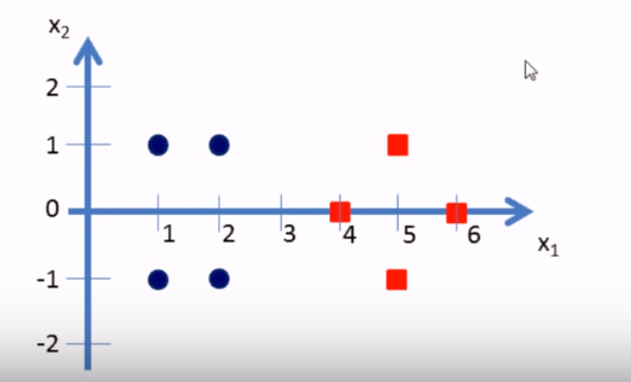

Slide 5
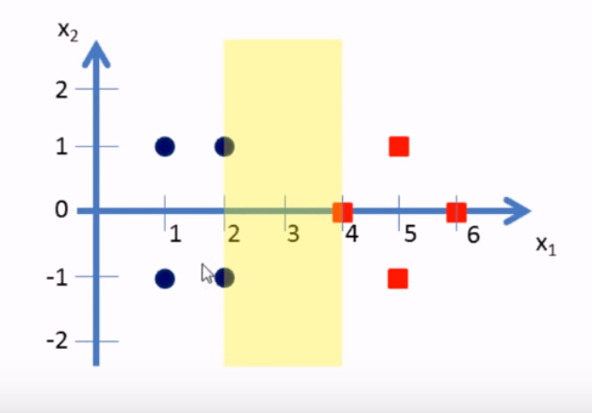

Slide 6
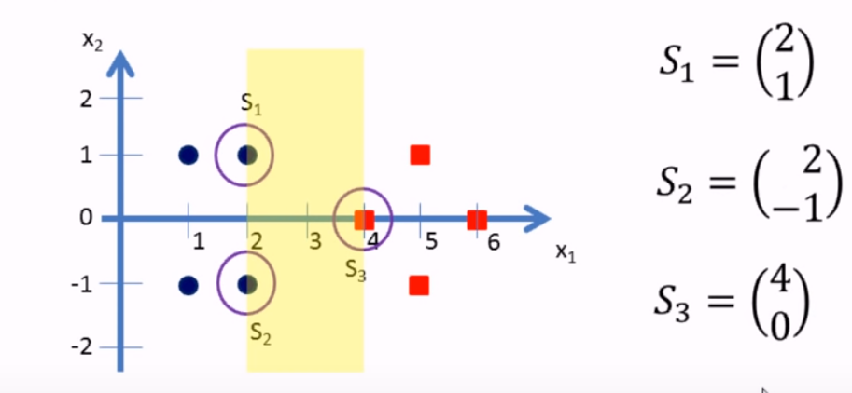

Slide 7
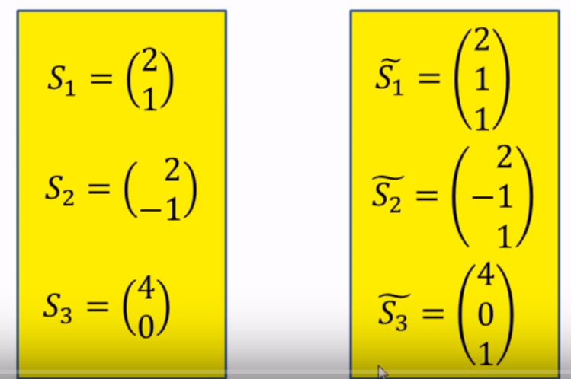

Slide 8
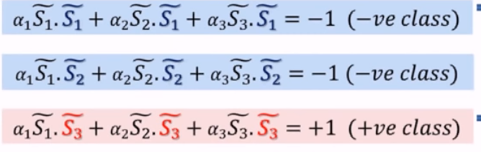

Slide 9
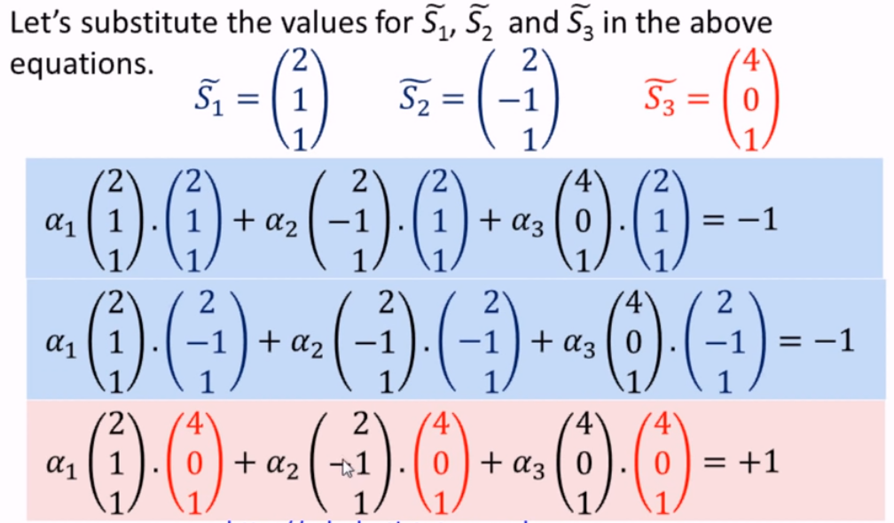

Slide 10
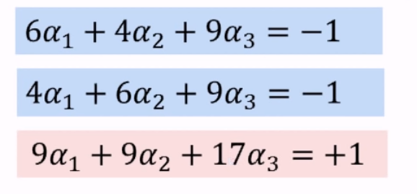
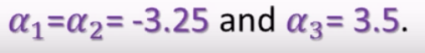

Slide 11
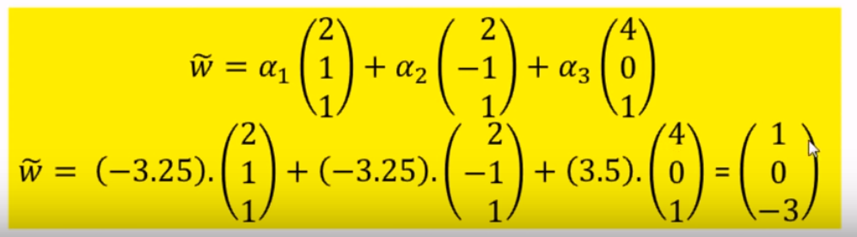

Slide 12
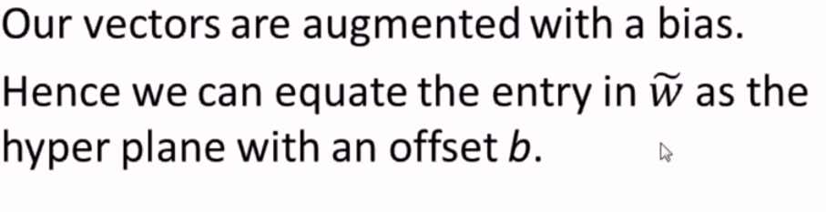

Slide 13
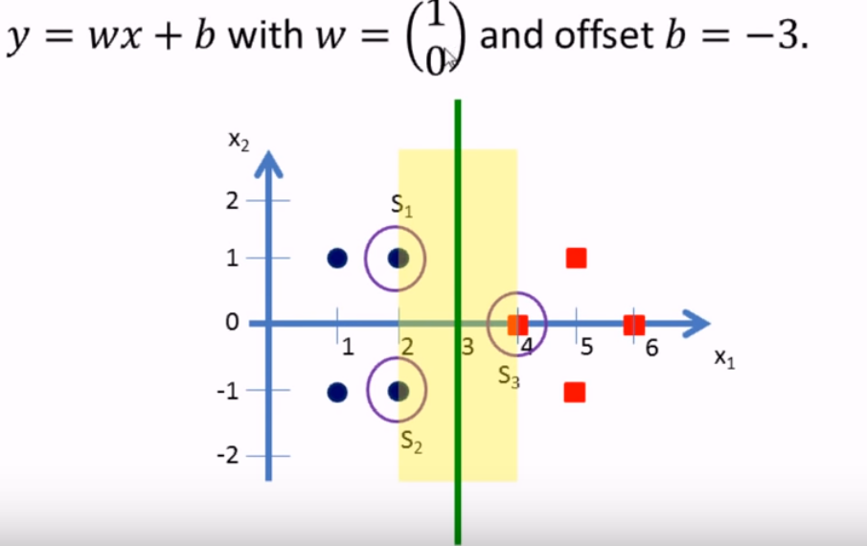

Slide 14
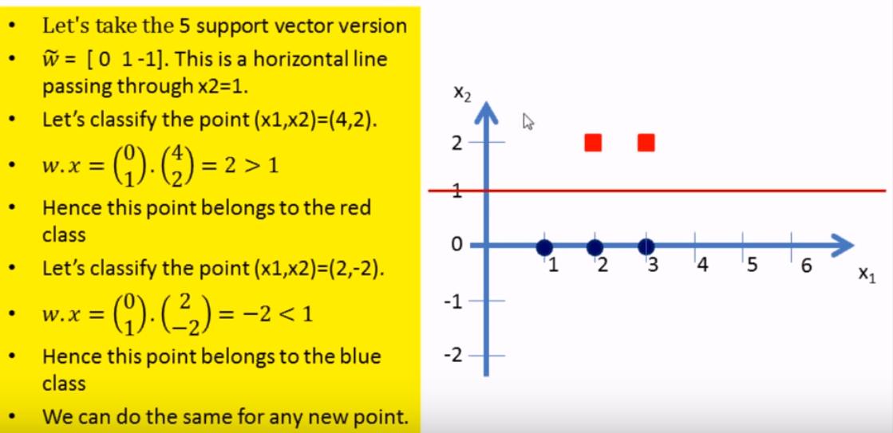
https://www.youtube.com/watch?v=LXGaYVXkGtg&list=WL&index=51

Slide 15
Non-linear SVM
Non-linear SVM means that the boundary that the algorithm calculates doesn't have to be a straight line. The benefit is that you can capture much more complex relationships between your datapoints without having to perform difficult transformations

Slide 16
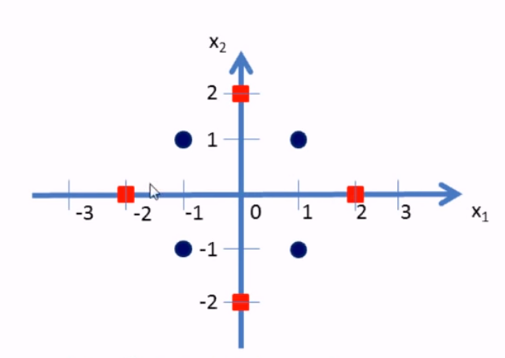

Slide 17
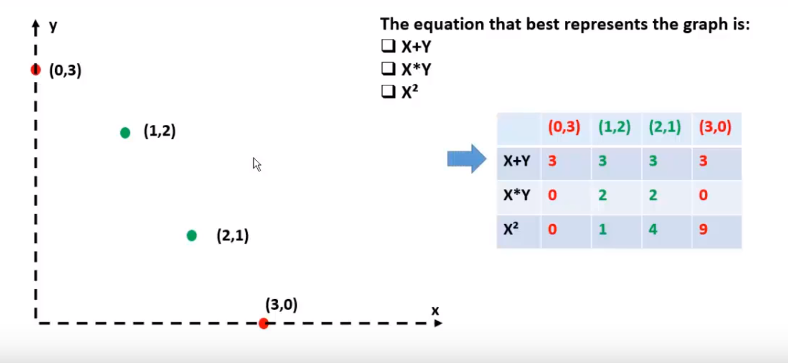

Slide 18
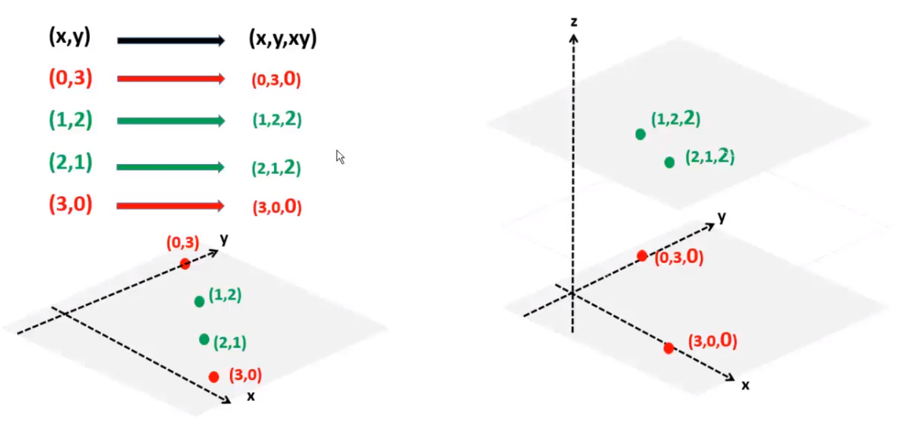

Slide 19
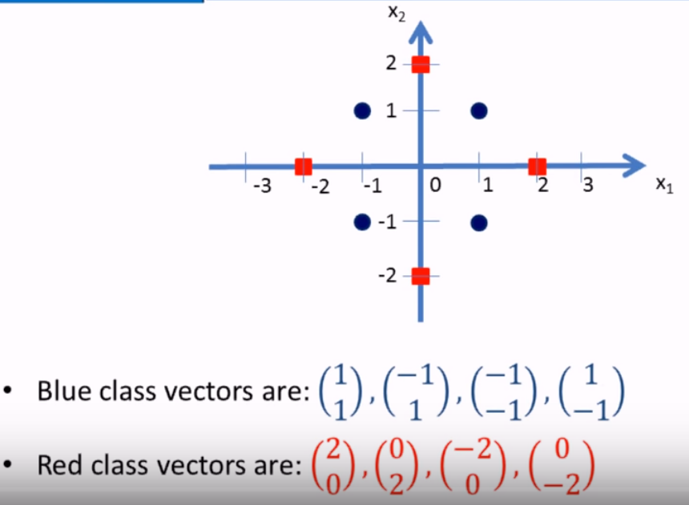

Slide 20
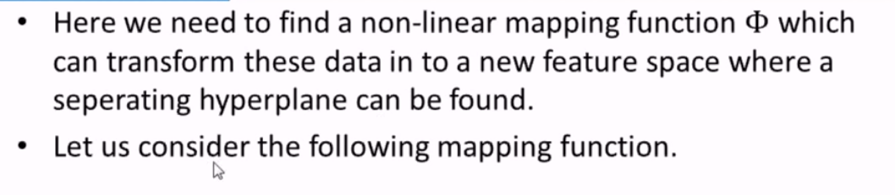
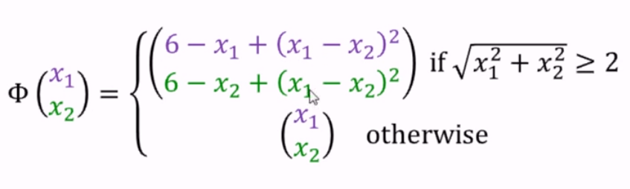

Slide 21
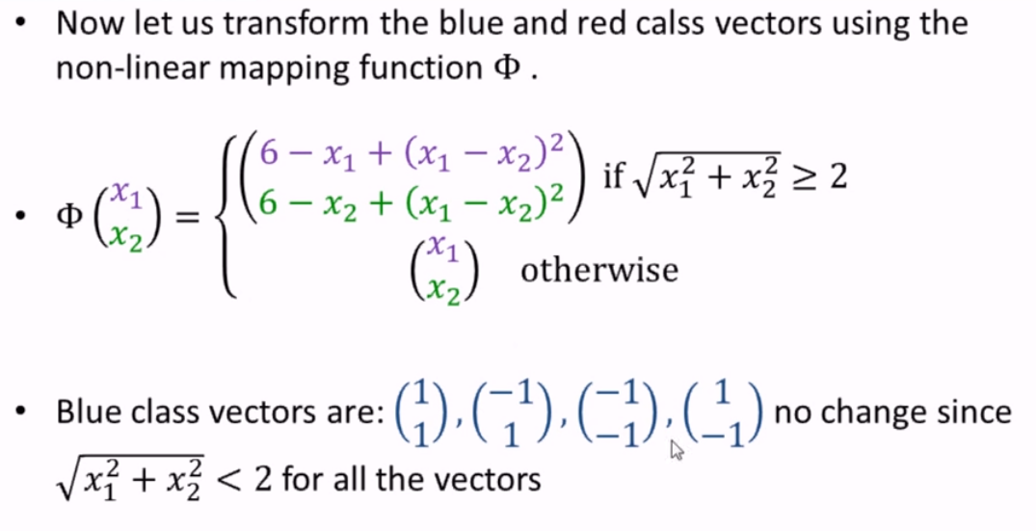

Slide 22
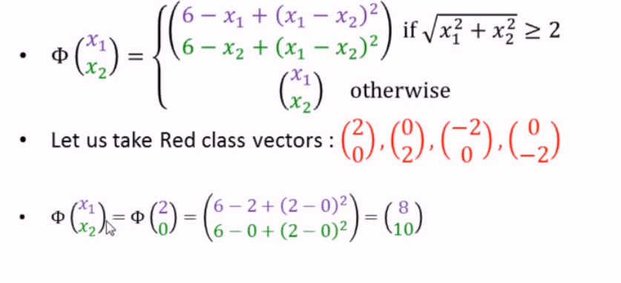

Slide 23
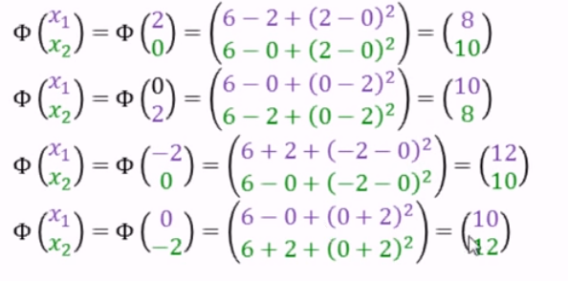

Slide 24
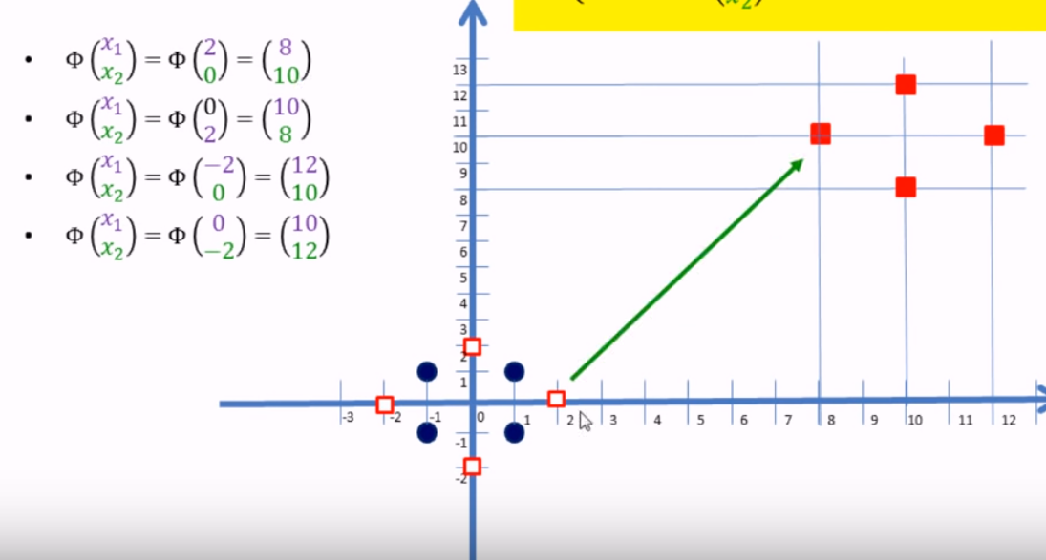

Slide 25
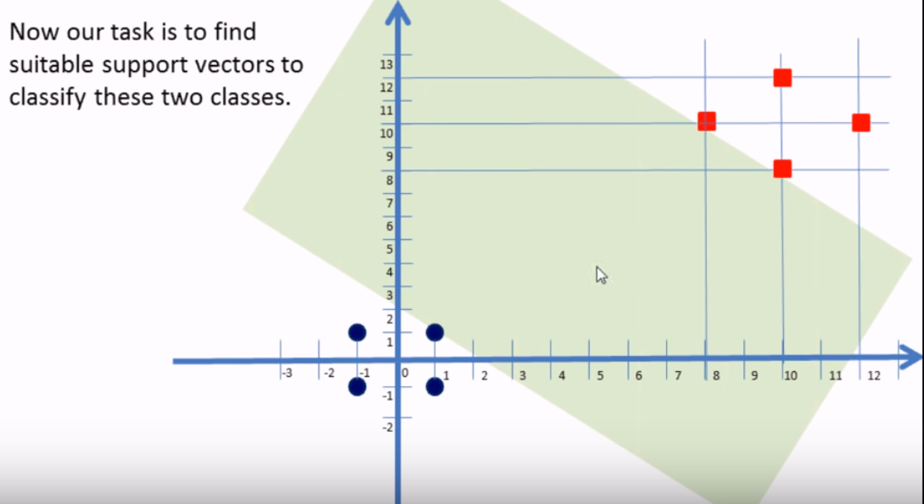
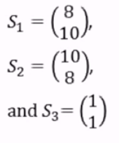

Slide 26
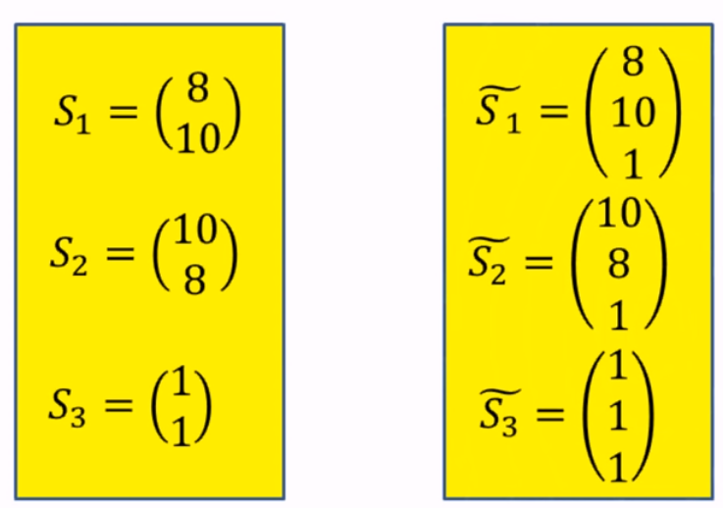
Bias input or augmented input

Slide 27
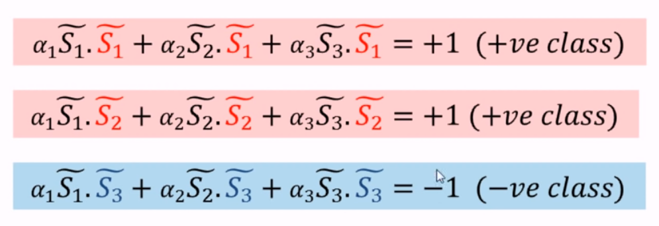

Slide 28
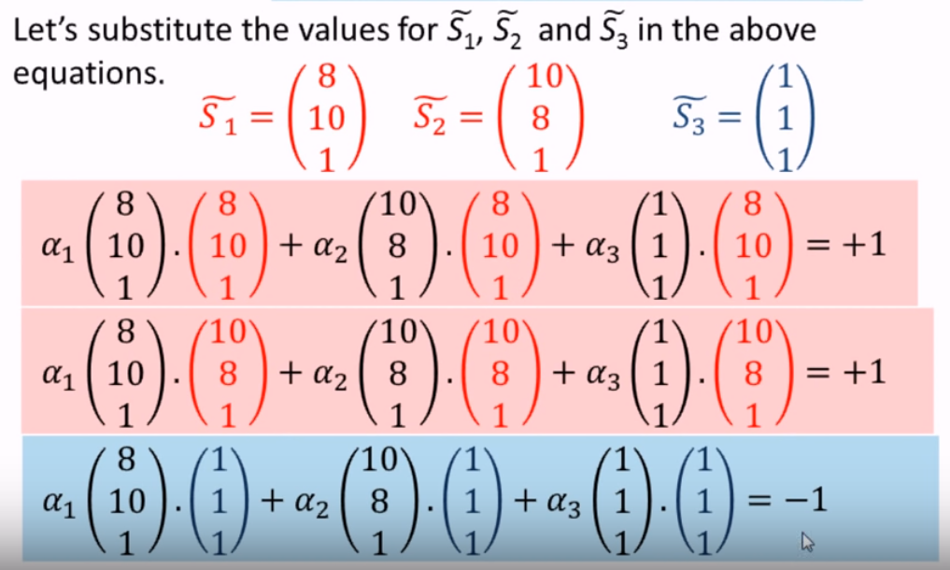

Slide 29
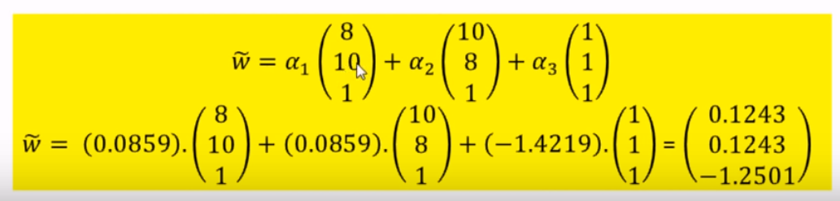

Slide 30
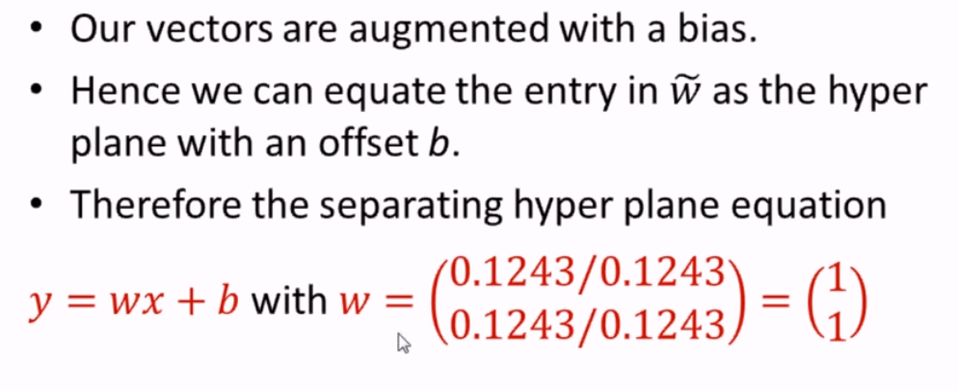

Slide 31
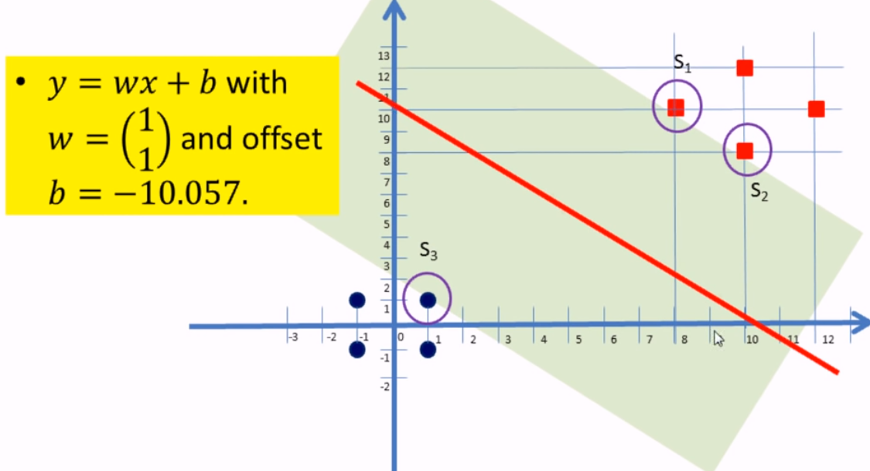

Slide 32
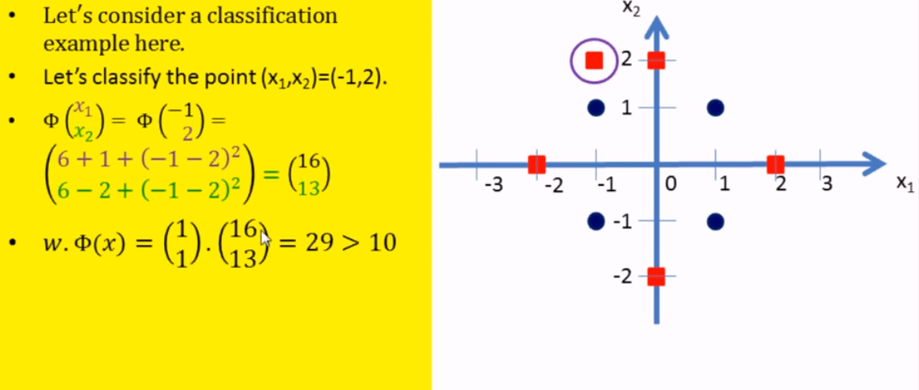

Slide 33
Pros and Cons associated with SVM
Pros:
It works really well with clear margin of separation
It is effective in high dimensional spaces.
It is effective in cases where number of dimensions is greater than the number of samples.
It uses a subset of training points in the decision function (called support vectors), so it is also memory efficient.
Cons:
It doesn’t perform well, when we have large data set because the required training time is higher
It also doesn’t perform very well, when the data set has more noise i.e. target classes are overlapping
SVM doesn’t directly provide probability estimates, these are calculated using an expensive five-fold cross-validation. It is related SVC method of Python scikit-learn library.

Slide 34
Resource to understand better
https://medium.com/machine-learning-101/chapter-2-svm-support-vector-machine-theory-f0812effc72
https://www.youtube.com/watch?v=LXGaYVXkGtg&list=WL&index=51
https://www.kdnuggets.com/2017/02/yhat-support-vector-machine.html
https://www.youtube.com/watch?v=6cJoCCn4wuU&t=170s
For kernel trick:
https://www.analyticsvidhya.com/blog/2017/09/understaing-support-vector-machine-example-code/

Slide 35
Learning Question
What is support vector?
How support vector works?
What is soft margin and hard margin?
What are the pros and cons of SVM?

